Slide 1

Investigation of Hierarchical Temporal Memory Spatial Pooler’s Noise Robustness and Specificity
Sang Nguyen
phuocsangnguyen97@gmail.com
Duy Nguyen
ngthanhduy7@gmail.com
Fachbereich 2 Informatik und Ingenieurwissenschaften

Slide 2
Contents
Introduction
Methods
Results and Discussion
Conclusion

Slide 3
Introduction
HTM Cortex Layer
Encoder
Spatial Pooler
Temporal Memory
Robustness

Slide 4
Introduction
Specificity - the ability to differentiate between two different inputs

Slide 5
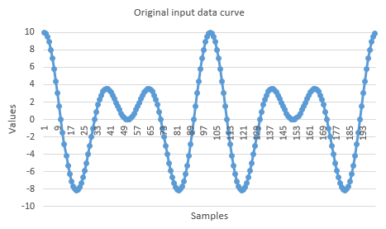
Methods
f(x) = 10 ∙ cos(0.01π ∙ x) ∙ cos(0.05π ∙ x)
Figure 1. The first 200 samples from the original input data set

Slide 6
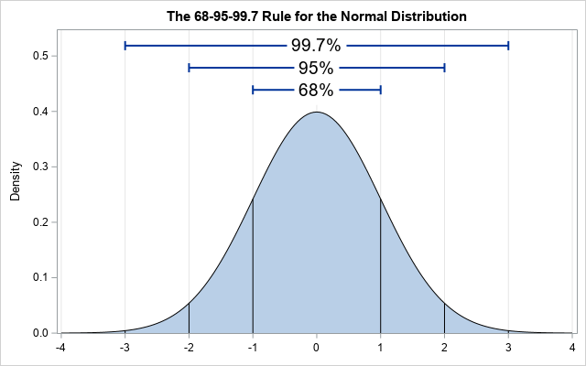
Methods
(Source: https://blogs.sas.com/content/iml/2019/07/22/extreme-value-normal-data.html#prettyPhoto)

Slide 7
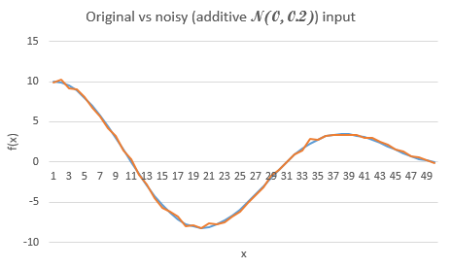
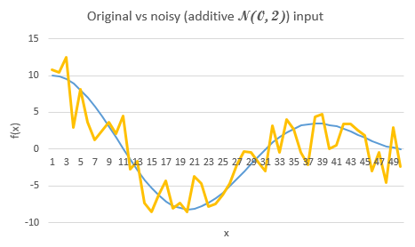
Methods
Figure 2. Comparison between original and noisy input data sets

Slide 8
Methods
Table 1. Scalar Encoder’s Settings
Parameter | Value
W | 65
N | 465
MinVal | -20.0
MaxVal | 20.0
Periodic | false
ClipInput | true
Offset | 108

Slide 9
Methods
Table 2. Spatial Pooler’s Settings
Parameter | Value
inputDimensions | 465
comlumnsDimension | 2048
potentialRadius | -1
potentialPct | 1
globalInhibition | true
numActiveColumnsPerInhArea | 0.02*2048 (2%)
stimulusThreshold | 0.5
synPermInactiveDec | 0.008
synPermActiveInc | 0.01
synPermConnected | 0.1
dutyCyclePeriod | 100
maxBoost | 10

Slide 10
Methods
Comparison function
public static double GetHammingDistance(int[] originArray, int[] comparingArray, bool countNoneZerosOnly = false)

Slide 11
Methods
Summarization
Noise-free input
Noise-free output
SCALAR ENCODER
SPATIAL POOLER
Noisy inputs
Noisy output
Possible input values in decreasing order
“Hamming” between an input value and the next one

Slide 12
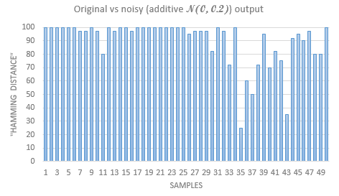
Result and Discussion
Figure 3. "Hamming distance" between original and noisy (N(0, 0.2)) Spatial Pooler output data sets with respect to the first 50 samples

Slide 13
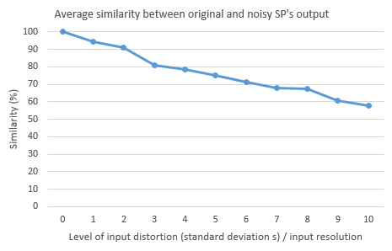
Result and Discussion
Figure 4. "Hamming distance" between original and noisy (N(0, 0.2)) Spatial Pooler output data sets with respect to the first 50 samples

Slide 14
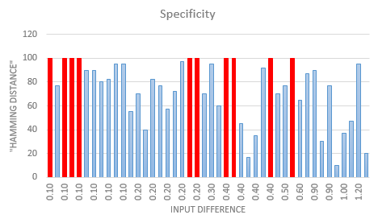
Result and Discussion
Figure 5. "Hamming distance" between outputs of trained Spatial Pooler with respect to two consecutively incremental input values regarding amplitude

Slide 15
Result and Discussion
Figure 6. Average "Hamming distance" between each 0.1 decimal step and the integer number

Slide 16
Conclusion
Noise robustness: robust against relatively low levels of noise
Specificity: Moderate ability to differentiate two consecutively incremental input values

Slide 17
Reference
[1] J. Hawkins and S. Blakeslee, On intelligence. New York: Times Books/Henry Holt, 2008.
[2] J. Hawkins and C. Maver, “Introduction Chapter,” in Biological and Machine Intelligence, Release 0.4., Numenta, 2016.
[3] J. Hawkins and C. Maver, “HTM Overview Chapter,” in Biological and Machine Intelligence, Release 0.4., Numenta, 2016.
[4] S. Purdy, “Encoding Data for HTM Systems,” in Biological and Machine Intelligence, Release 0.4., Numenta, 2016.
[5] S. Ahmad, M. Taylor, and Y. Cui, “Spatial Pooling Algorithm Details,” in Biological and Machine Intelligence, Release 0.4., Numenta, 2016.
[6] A. Lavin, S. Ahmad, and J. Hawkins, “Sparse Distributed Representations,” in Biological and Machine Intelligence, Release 0.4., Numenta, 2016.
[7] S. Ahmad and M. Lewis, “Temporal Memory Algorithm Details,” in Biological and Machine Intelligence, Release 0.4., Numenta, 2016.
[8] D. Dobric, “Influence of input sparsity to Hierarchical Temporal Memory Spatial Pooler noise robustness,” 2019.
[9] Frankfurt University of Applied Sciences, [Online]. Available: https://github.com/UniversityOfAppliedSciencesFrankfurt/se-cloud-2019-2020. [Accessed: 23-Mar-2020].

